Slide 1
CSE408
Brute Force(String Matching, Closest pair, Convex hull,Exhaustive,Voronori diagrams
Lecture # 7&8

Slide 2
Answer the question
Suppose you forgot the password of your laptop and it is 4 digit password and you remember the digits it was combination of 4,5,7,6. Max in how many attempts you will get your password.

Slide 3
Brute Force
A straightforward approach, usually based directly on the problem’s statement and definitions of the concepts involved
Arrange the numbers in Sequence:-
23,2,34,1,8,10,89,45,65,76,98
Examples:
Computing a^{n} (a > 0, n a nonnegative integer)
Computing n!
Multiplying two matrices
Searching for a key of a given value in a list

Slide 4
Brute-Force Sorting Algorithm
Selection Sort Scan the array to find its smallest element and swap it with the first element. Then, starting with the second element, scan the elements to the right of it to find the smallest among them and swap it with the second elements. Generally, on pass i (0 ≤ i ≤ n-2), find the smallest element in A[i..n-1] and swap it with A[i]:
A[0] ≤ . . . ≤ A[i-1] | A[i], . . . , A[min], . . ., A[n-1]
in their final positions
Example: 7 3 2 5

Slide 5
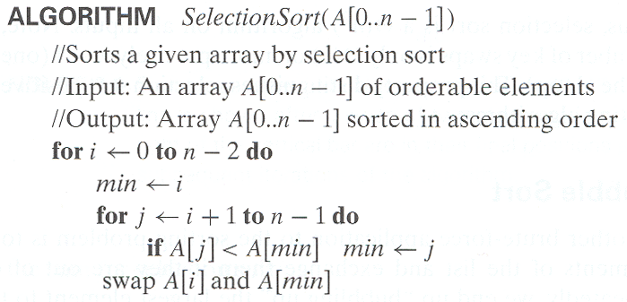
Analysis of Selection Sort
Time efficiency:
Space efficiency:
Stability:
Θ(n^2)
Θ(1), so in place
yes

Slide 6
String Matching
Pattern: 001011 Text: 10010101101001100101111010
Pattern: happy Text: It is never too late to have a happy childhood.

Slide 7
Brute-Force String Matching
pattern: a string of m characters to search for
text: a (longer) string of n characters to search in
problem: find a substring in the text that matches the pattern
Brute-force algorithm
Step 1 Align pattern at beginning of text
Step 2 Moving from left to right, compare each character of
pattern to the corresponding character in text until
    all characters are found to match (successful search); or
    a mismatch is detected
Step 3 While pattern is not found and the text is not yet
exhausted, realign pattern one position to the right and
repeat Step 2

Slide 8
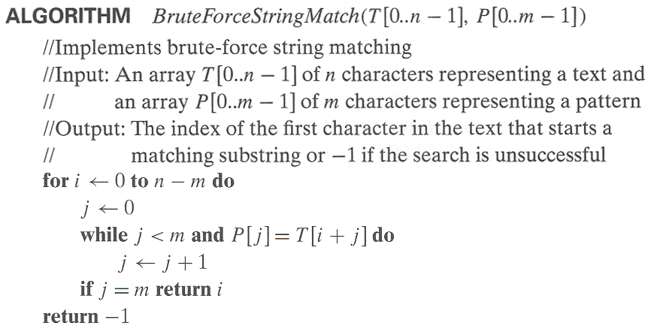
Pseudocode and Efficiency
Time efficiency:
Θ(mn) comparisons (in the worst case)
Why?

Slide 9
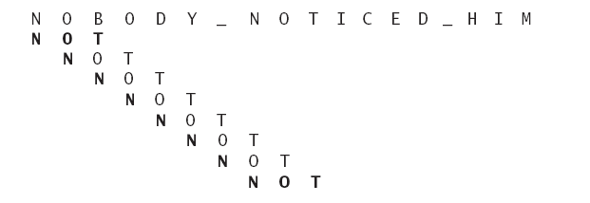

Slide 10
Exhaustive Search
A brute force solution to a problem involving search for an element with a special property, usually among combinatorial objects such as permutations, combinations, or subsets of a set.
Method:
  generate a list of all potential solutions to the problem in a systematic manner (see algorithms in Sec. 5.4)
  evaluate potential solutions one by one, disqualifying infeasible ones and, for an optimization problem, keeping track of the best one found so far
  when search ends, announce the solution(s) found

Slide 11
a
b
c
d

Slide 12
Example 1: Traveling Salesman Problem
Given n cities with known distances between each pair, find the shortest tour that passes through all the cities exactly once before returning to the starting city
Alternatively: Find shortest Hamiltonian circuit in a weighted connected graph
Example:
2
a
b
5
3
8
4
c
d
7
How do we represent a solution (Hamiltonian circuit)?

Slide 13
TSP by Exhaustive Search
Tour Cost
a→b→c→d→a 2+3+7+5 = 17
a→b→d→c→a 2+4+7+8 = 21
a→c→b→d→a 8+3+4+5 = 20
a→c→d→b→a 8+7+4+2 = 21
a→d→b→c→a 5+4+3+8 = 20
a→d→c→b→a 5+7+3+2 = 17
Efficiency:
Chapter 5 discusses how to generate permutations fast.
Θ((n-1)!)

Slide 14
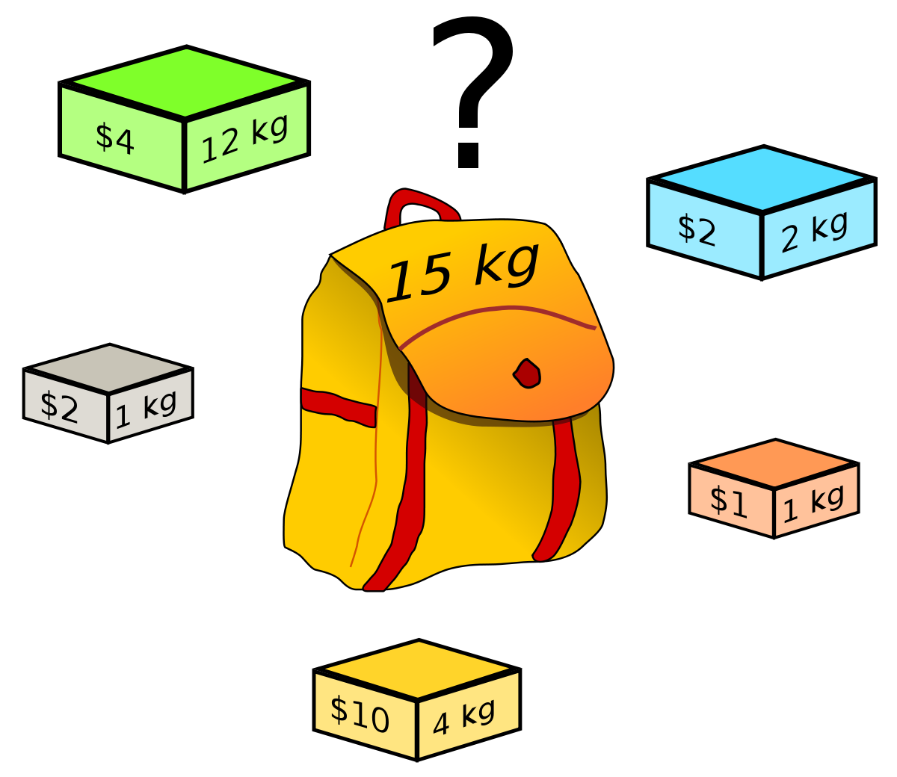
Knapsack problem

Slide 15
Example 2: Knapsack Problem
Given n items:
  weights: w₁ w₂ … w_{n}
  values: v₁ v₂ … v_{n}
  a knapsack of capacity W
Find most valuable subset of the items that fit into the knapsack
Example: Knapsack capacity W=16
item weight value
2 $20
5 $30
10 $50
5 $10

Slide 16
Knapsack Problem by Exhaustive Search
Subset Total weight Total value
{1} 2 $20
{2} 5 $30
{3} 10 $50
{4} 5 $10
{1,2} 7 $50
{1,3} 12 $70
{1,4} 7 $30
{2,3} 15 $80
{2,4} 10 $40
{3,4} 15 $60
{1,2,3} 17 not feasible
{1,2,4} 12 $60
{1,3,4} 17 not feasible
{2,3,4} 20 not feasible
{1,2,3,4} 22 not feasible
Efficiency:
Θ(2^n)
Each subset can be represented by a binary string (bit vector, Ch 5).

Slide 17
Assignment Problem by Exhaustive Search
9 2 7 8
6 4 3 7
5 8 1 8
7 6 9 4
Assignment (col.#s) Total Cost
1, 2, 3, 4 9+4+1+4=18
1, 2, 4, 3 9+4+8+9=30
1, 3, 2, 4 9+3+8+4=24
1, 3, 4, 2 9+3+8+6=26
1, 4, 2, 3 9+7+8+9=33
1, 4, 3, 2 9+7+1+6=23
etc.
(For this particular instance, the optimal assignment can be found by exploiting the specific features of the number given. It is:
C =
2,1,3,4

Slide 18
Final Comments on Exhaustive Search
Exhaustive-search algorithms run in a realistic amount of time only on very small instances
In some cases, there are much better alternatives!
  minimum spanning tree
In many cases, exhaustive search or its variation is the only known way to get exact solution

Slide 19
Vornoi diagram
The partitioning of a plane with points into convex polygons such that each polygon contains exactly one generating point and every point in a given polygon is closer to its generating point than to any other.
A Voronoi diagram is sometimes also known as a Dirichlet tessellation. The cells are called Dirichlet regions, Thiessen polytopes, or Voronoi polygons.

Slide 20
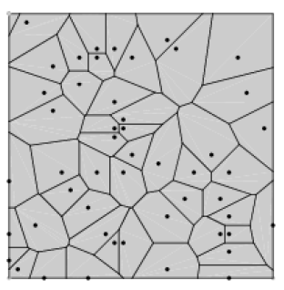

Slide 21
Voronoi diagrams were considered as early at 1644 by René Descartes and were used by Dirichlet (1850) in the investigation of positive quadratic forms.
They were also studied by Voronoi (1907), who extended the investigation of Voronoi diagrams to higher dimensions.
They find widespread applications in areas such as computer graphics, epidemiology, geophysics, and meteorology

Slide 22
Brute-Force Polynomial Evaluation
Problem: Find the value of polynomial
p(x) = a_{n}x^{n} + a_{n-1}x^{n-1} +… + a₁x¹ + a₀
at a point x = x₀
Brute-force algorithm
Efficiency:
p ← 0.0
for i ← n downto 0 do
power ← 1
  for j ← 1 to i do //compute x^{i}
  power ← power ∗ x
  p ← p + a[i] ∗ power
return p
Σ0≤i≤n i = Θ(n^2) multiplications

Slide 23
Polynomial Evaluation: Improvement
We can do better by evaluating from right to left:
Better brute-force algorithm
Efficiency:
Horner’s Rule is another linear time method.
p ← a[0]
power ← 1
for i ← 1 to n do
    power ← power ∗ x
  p ← p + a[i] ∗ power
  return p
Θ(n) multiplications

Slide 24
Closest-Pair Problem
Find the two closest points in a set of n points (in the two-dimensional Cartesian plane).
Brute-force algorithm
Compute the distance between every pair of distinct points
and return the indexes of the points for which the distance is the smallest.
Notes:
Draw example.

Slide 25
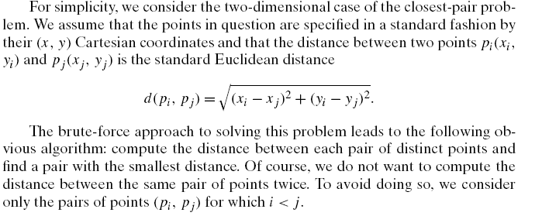

Slide 26
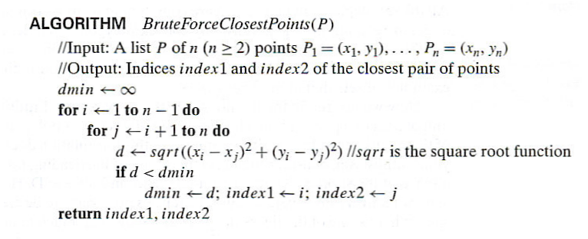
Closest-Pair Brute-Force Algorithm (cont.)
Efficiency:
How to make it faster?
Θ(n^2) multiplications (or sqrt)
Using divide-and-conquer!
Notes:
The basic operation of the algorithm is computing the Euclidean distance between two points.
The square root is a complex operation who’s result is often irrational, therefore the results
can be found only approximately. Computing such operations are not trivial. One can avoid
computing square roots by comparing distance squares instead.

Slide 27
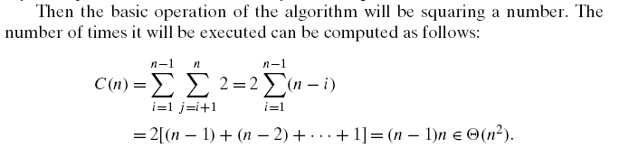

Slide 28

Convex Hull Problem

Slide 29
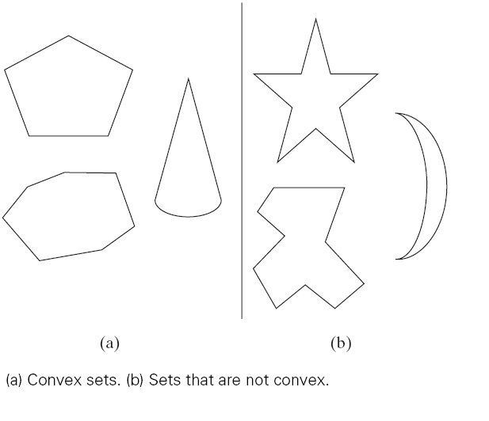

Slide 30
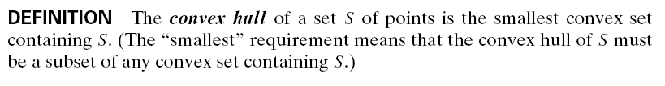

Slide 31
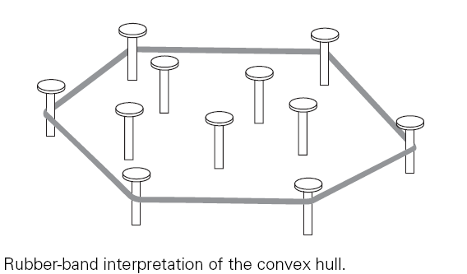

Slide 32
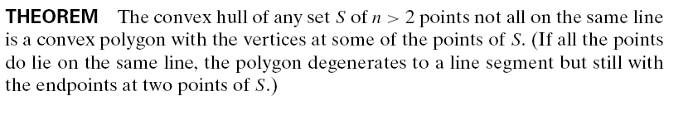

Slide 33
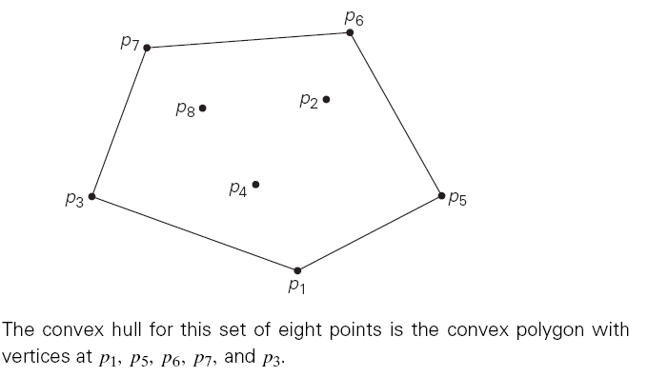

Slide 34
The convex-hull problem is the problem of constructing the convex hull for a given set S of n points
To solve it, we need to find the points that will serve as the vertices of the polygon in question.
Mathematicians call the vertices of such a polygon “extreme points.”
By definition, an extreme point of a convex set is a point of this set that is not a middle point of any line segment with endpoints in the set.

Slide 35
how can we solve the convex-hull problem in a brute-force manner?
Nevertheless, there is a simple but inefficient algorithm that is based on the following observation about line segments making up the boundary of a convex hull
a line segment connecting two points pi and pj of a set of n points is a part of the convex hull’s boundary if and only if all the other points of the set lie on the same side of the straight line through these two points

Slide 36
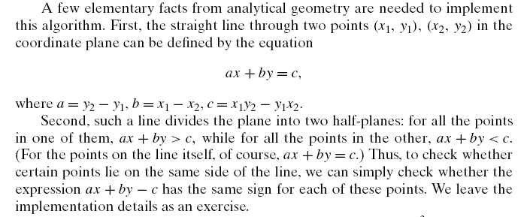

Slide 37
Brute-Force Strengths and Weaknesses
Strengths
  wide applicability
  simplicity
  yields reasonable algorithms for some important problems
  (e.g., matrix multiplication, sorting, searching, string matching)
Weaknesses
  rarely yields efficient algorithms
  some brute-force algorithms are unacceptably slow
  not as constructive as some other design techniques

